Slide 1


K.RAMAKRISHNAN COLLEGE OF TECHNOLOGY
(AUTONOMOUS), TRICHY.
DEPARTMENT OF
COMPUTER SCIENCE AND ENGINEERING
20CS5501 DESIGN PROJECT-1
Batch No. : 18
Date : 07.12.2024

Slide 2
MORPH DETECTION
Guided by Team Members
Ms. M PAVITHRA SANJAY RAMAJAYAM M(811722104131)
Assistant Professor, CSE SUDEESH B (811722104160)
SUNDAR B (811722104161)

Slide 3
OBJECTIVE OF THE PROJECT
The primary objective of the system is to develop a robust and efficient solution for detecting and classifying morphed facial images to enhance the security and reliability of biometric authentication systems.
By leveraging advanced deep learning techniques and machine learning classifiers, the system aims to accurately differentiate between live-captured (original) images and morphed (manipulated) images.
This ensures the integrity of facial recognition systems and prevents unauthorized access or identity spoofing.
The solution is designed to strengthen high-security applications, such as identity verification, passport authentication, and secure access control, while mitigating risks associated with facial data manipulation and ensuring trust in biometric systems.

Slide 4
ABSTRACT
This system addresses the critical challenge of detecting morphed facial images, which pose a significant threat to the security and reliability of biometric authentication systems. Morphing attacks, where facial images are manipulated to combine features from multiple individuals, can deceive facial recognition technologies and compromise identity verification processes. The proposed solution employs a multi-step approach, beginning with face extraction, followed by deep learning-based feature extraction and further refinement. A Support Vector Machine (SVM) classifier is then used to accurately classify images as either original or morphed. By effectively mitigating the risks associated with facial image manipulation, this approach enhances trust and reliability in critical identity-based systems.

Slide 5
LITERATURE SURVEY
TITLE OF THE PAPER | AUTHOR (S) | PUBLISHER | PAPER GIST | TECHNOLOGY USED
DEEPFAKE DETECTION WITH CNN | Yuezum Li and Siwei Lyu | EEE/CVF Conference on Computer Vision and Pattern Recognition (CVPR) | This approach utilizes CNNs to analyze facial inconsistencies that are commonly present in synthetic media, making it effective for detecting deepfake videos. | Convolutional Neural Networks
EXPOSING DEEPFAKE VIDEOS BY DETECTING FACE WRAPPING ARTIFACTS | Hany Farid and Shruthi Agarwal | IEEE Transactions on Information Forensics and Security (TIFS) | This study introduces a deepfake detection approach that focuses on detecting face warping artifacts, a common indicator of manipulation | Convolutional Neural Networks , Recurrent Neural Networks
A SURVEY ON DEEPFAKE DETECTION METHODS: CHALLENGES AND FUTURE DIRECTIONS | Shu Hu, Siqi Zheng, and Rajesh Gupta | IEEE Access | It examines both manual and automated approaches, discussing the adaptability of detection methods in response | deep learning models (CNNs, RNNs, GANs), and temporal analysis methods.
DeepFake Video Detection through Visual and Audio Information | Ng, E., & Teoh, A | IEEE Access | This paper addresses the combination of visual and audio cues to improve the detection of DeepFake videos, highlighting the importance of multisensory analysis for effective detection. | SVM , Convolutional Neural Networks , Recurrent Neural Networks
Morph Detection: A Novel Approach for Detecting Fake Faces Using Deep Learning | Y. Zhang, Y. Xu, M. Wang, W. Li, J. Yang, Z. Liu | IEEE Access | This paper proposes a new method for deepfake face detection specifically focused on detecting manipulated facial images using deep learning. | Convolutional Neural Networks , Image Preprocessing

Slide 6
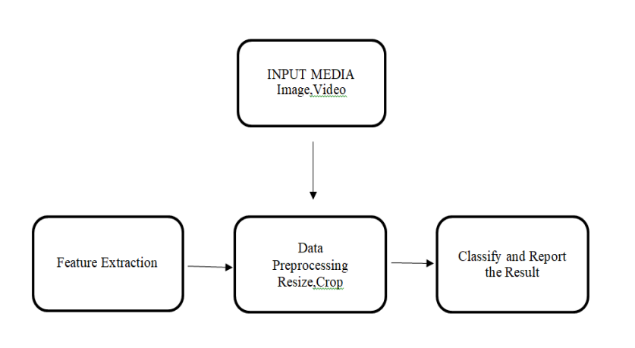
EXISTING SYSTEM ARCHITECTURE

Slide 7
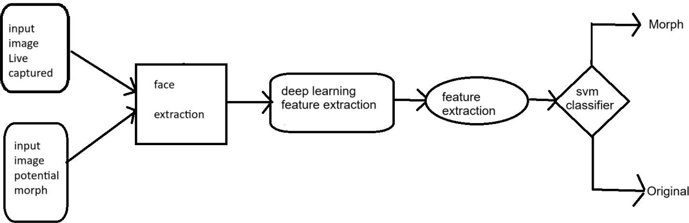
PROPOSED SYSTEM ARCHITECTURE

Slide 8
SOFTWARE AND HARDWARE REQUIREMENTS
HARDWARE
SOFTWARE
Camera
8GB RAM
Power Supply(DC Power)
Window OS
Python

Slide 9
MODULES
DATA ACQUISITION MODULE
PREPROCESSING MODULE
FEATURE EXTRACTION MODULE
MORPH DETECTION MODULE
AUTHENTICATION AND REPORTING MODULE

Slide 10
SUMMARY OF MODULE-1
DATA ACQUISITION MODULE
This module is responsible for obtaining the input data from various sources, such as video files, image files, or live camera feeds. The data may come from online platforms, surveillance footage, or uploaded user media. It ensures that the system has access to the relevant media that needs to be tested for morphing or deepfake manipulation.

Slide 11
SUMMARY OF MODULE-2
PREPROCESSING MODULE
This module handles the necessary preprocessing steps to make the data suitable for analysis. It involves operations such as resizing images or frames, normalizing pixel values, removing noise, and sometimes detecting and aligning faces in images. Preprocessing is critical to ensure consistency and quality of the input data.

Slide 12
SUMMARY OF MODULE-3
FEATURE EXTRACTION MODULE
This module applies machine learning or deep learning techniques to extract relevant features from the data. Feature extraction helps the system identify patterns, textures, and facial structures that can indicate if an image or video has been morphed. Convolutional Neural Networks (CNNs) or other deep learning models are often used in this module to perform feature extraction.

Slide 13
SUMMARY OF MODULE-4
MORPH DETECTION MODULE
This is the core module for detecting morphing artifacts. The morph detection algorithm analyzes the features extracted from the previous module to identify signs of morphing. It could look for discrepancies such as inconsistent facial features, unnatural blending, or pixel-level inconsistencies that are characteristic of deepfake or morphing techniques.

Slide 14
SUMMARY OF MODULE-5
AUTHENTICATION AND REPORTING MODULE
This module is responsible for verifying whether the media is authentic or has been tampered with. It may include a reporting feature that provides detailed results about the analysis, including the detected manipulations and their severity. Additionally, the authentication results might be integrated with a user interface for easier interpretation.

Slide 15

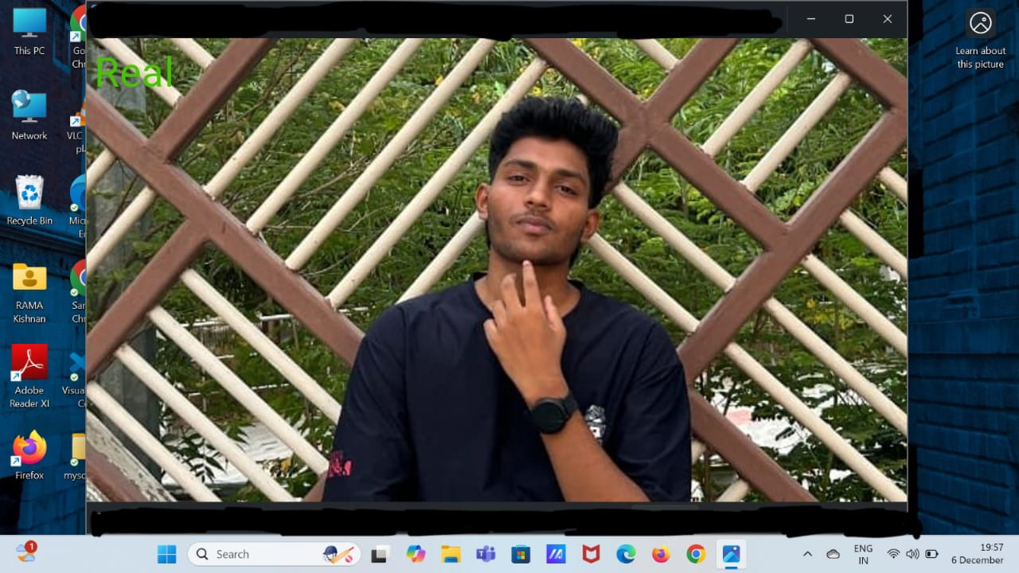
RESULTS AND DISCUSSION

Slide 16
CONCLUSION
Key Points:
Objective: Detect and classify morphed facial images to secure biometric systems.
Approach:
Data acquisition via live feeds or media files.
Preprocessing for image quality and consistency.
Feature extraction using deep learning techniques like CNNs.
Morph detection via SVM classifier to identify tampering.
Authentication and reporting for actionable insights.
Applications: High-security areas like passport verification, secure access, and identity authentication.

Slide 17
THANK YOU

